Slide 1

Sprint Mobile Solutions
Virtual Home Automation Hub
July 2018

Slide 2
Concept Idea – Virtual Home Automation Hub
Develop a Virtual Home Automation Hub approach that brings together the many different IOT standards (Zigbee, X10, KNX, Z-wave, 5G, Alexa, Google Home, etc.) and communications capabilities.
Introduce 5G (telecom device, always on, always connected, registered device) device capabilities into a consumer’s environment and experiences using the Automation Hub as the central registration.
5G Home Media Player Unit
5G Connected Refrigerator
Provide a single user portal for consumers to manage their experience, devices, logic patterns (day, evening, scene, event) or location.
Provide basic security of a user’s profile and identity.

Slide 3
Idea Generation – Sample Use Cases
As a consumer with a Sprint Virtual Home Automation Hub, I can manage all of my devices through one Sprint portal. This includes all smart home devices, security, lights, plugs regardless of their protocol used to communicate. (Zigbee, X10, KNX, Z-wave, Bluetooth, Wifi, 5G, Serial).
As a registered user profile, if any location that uses a Sprint Automation Virtual Hub, I can re-use my own profile settings at the destination/location.
Bill automates his home using Sprint Automation Virtual Hub. Bill then travels to his favorite vacation spot at the Lake of the Ozarks which is also automated. Bill can re-use his own profile/commands and scenes at his vacation spot. The device will be smart-aware of his presence, adjust his portal to account for what devices are available, and interpret his logical settings and/or voice commands.
As a guest in a house/location with Sprint Automation Virtual Hub, a guest may temporarily use the services available in the home with permission.
If new devices are detected in a destination/location, the user can be sent product or elect to receive product or device enrollment details to use the service (e.g. 5G enabled media home player/gaming system/etc). A vacation or hotel location offers Netflix with a 5G enabled box. User is sent an offer request upon arrival to use the service.

Slide 4
Technical Merits – Proof of Concept
Prove integration with Sprint data:
Use provided APIs to retrieve customer and device information from Sprint
Device types shall be ‘light’, ‘socket’, ‘camera’, ‘media’, ‘5G’, ‘appliance’
Prove conceptual logic of a Sprint Automated Virtual Hub:
Using customer/device information, logically prove device states: on/off/cmd sent
Prove the user is securely managed on the portal.
Prove the user, using a single portal, can send commands (logically) from their interface to the destination devices and change their state or process a command. No physical devices required – use logical entities to receive a state/message.

Slide 5
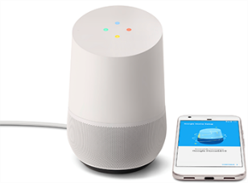
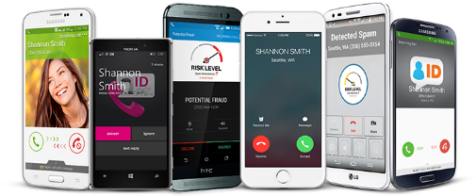
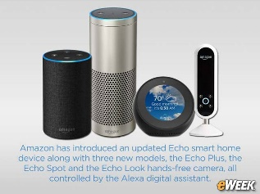
Logical Architecture
Customer &
Device Info
Sprint
Customer APK
Sprint
Virtual Home Automation Hub
Sprint Server
(JSON)
Admin Mode
Google
Home
Amazon
Alexa
Sprint Web Portal
IOT Device Interface
Zigbee
Sprint 5G Magic Box (signal boost, wifi)
Sprint 5G Home Media Player
Nest Smart Thermostat
Samsung Refrigerator
LG Washer/Dryer
WeMo Switch Smart Plug
Philips Hue Smart Bulbs
August Smart Lock
Canary Smart Security System
Samsung SmartThings Hub
Alexa Echo
Google Home
Z-Wave
X10
JSON
5G Protocol

Slide 6
IOT Device Registration – APK Method
Customer launches Sprint APK
Customer sets to Admin
Device scans for all protocols and comm channels (wifi, Zigbee, Z-Wave, X10, Alexa, Google Home, 5G, etc)
APK presents all found devices to customer to auto-register with Sprint Virtual Home Automation Hub
Device APK registers all devices that were confirmed to Hub
Admin Mode
Customer defines their custom profile and commands
Customer can test their profile from app.
Customer defines location security profile settings (who is authorized to use)
Customer saves location profile under a registered site settings.

Slide 7
IOT Device Registration – Web Portal
Customer launches Sprint APK
Customer sets to Admin
Devices are entered (manually) for all protocols and comm channels (wifi, Zigbee, Z-Wave, X10, Alexa, Google Home, 5G, etc)
APK presents all found devices to customer to auto-register with Sprint Virtual Home Automation Hub
APK registers confirmed devices to Hub
Admin Mode
Customer defines their custom profile and commands
Customer can test their profile from app.
Customer defines location security profile settings (who is authorized to use)
Customer saves location profile under a registered site settings.

Slide 8
Technology Features
Security features of a handset, IOT device that will register with the Sprint Hub
Location ‘aware’ of any handset, 5G device, or IOT device.
Device registration manager at any service location using a handset app.
Profile management and security of any registered user using the Sprint Hub
‘Personality’ customized commands to be used virtually anywhere of a registered user

Slide 9
Patent Ideas
Develop a new 5G protocol for communicating with IOT devices?
Security and method of IOT devices registering to a Sprint Virtual Hub
Concept of Virtual profile with a Virtual Hub –
customized IOT commands per user –
“follow me” capability – location based awareness and login to hub
Offer of products due to virtual hub enrollment
Site arrival notifications, awareness, registration, authentication, authorization

Slide 10
Inventors
Bill McCracken – Primary

